Slide 1

Data Driven Education
Discussion Forum Subteam
Presentation 2 - 10/27/2021
Notes:
Pratik

Slide 2

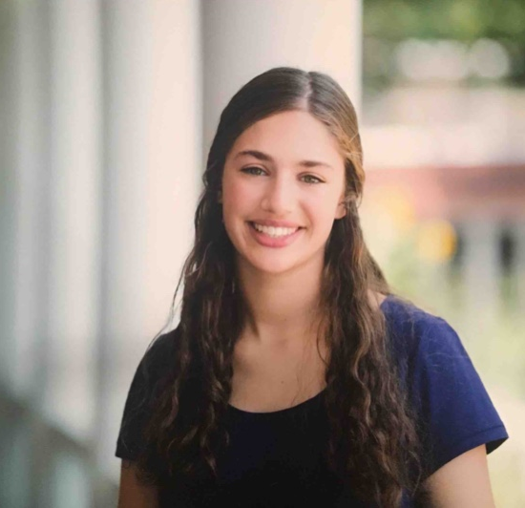
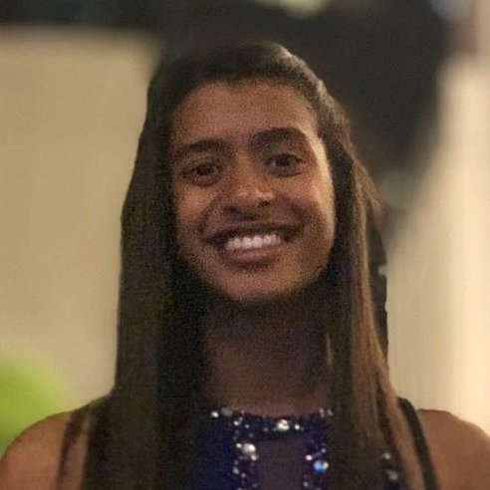


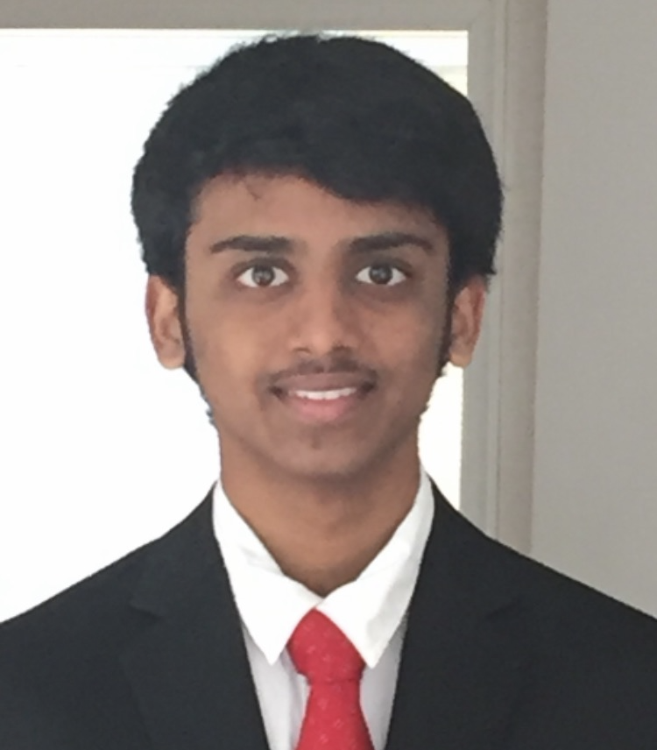

Team Members
Malav Patel
Data Scientist
Sarah Kaufman
Data Scientist
Nidhi Pai
Data Scientist
Pratik Agarwal
Project Manager
Aanya Khandelwal
Back-end
Developer
Gautam Sugasi
Back-end
Developer
Sambhav Jaideep
Front-end
Web Developer
Notes:
All

Slide 3


Introduction
Discussion forums
  Online formats - primary source of interaction
  CS 6601 - 155 threads, 1494 comments
Student interaction
  Cognitive presence
  Social presence
Activity on forums indicative of student engagement and interest
Goal: Creating a web application to be used by professors to make their courses more effective and engaging
Notes:
Just as a refresher, we’re working with Discussion forums data on Piazza from Dr. Thad Starner’s CS 6601 course. Discussion forums are particularly interesting since they’re the primary platform for student interaction in an online setting, and our goal in that context is to create a web-app that can be used by instructors to make their courses more effective and engaging.

Slide 4
Overview of how the data is being used
Cognitive Presence
Sentiment Analysis
Student Outcomes
Piazza
Model
(Calculation of metrics)
Social Presence
SQL database
+ CSV files
Manual Coding
View
(Dashboard with relevant metrics)
Controller
(Backend logic)
Instructor
Notes:
Here is an overview of the architecture of the web-app. We’re using the MVC, or the model-view-controller framework. There are 4 key components here: The view, the model, the database and the controller. The View is what the instructor can see and interact with, which is a dashboard displaying student metrics in our case. The Model is where the calculation for these metrics happens, and this can involve sentiment analysis, cognitive presence analysis, etc. The model uses data from the SQL database or the csv files, which also contain the manually labelled comments from Piazza, and returns the outputs to the controller. The controller is the middleman that tells the model what to compute based on the user’s input, and also controls what to send to the View to be displayed on the dashboard.

Slide 5
Progress updates brief
Data Science
  Preliminary sentiment analysis model ready to be integrated with the web-app
  Reviewing recent research on social presence analysis, and analysis of student outcomes
UX research
  Survey to send out is ready, interviews to be conducted in the coming weeks
Web-dev
  Working together with the data science team to identify relevant metrics and integrate models with the web-app
Notes:
The data science team is focused on the Model, while the web-app team is concerned mostly with the view and controller. To give a glimpse into our progress so far, the data science team is ready with a preliminary sentiment analysis model for integrating with the web-app. The web-dev team is working closely on this integration, and simultaneously sending out surveys to conduct needs analysis for informing our interface design. At the same time, we’ve been looking at the recent research on social presence to help focus our research goals on that front. Now, I’ll let the teams walk through the details, starting with the data science team.

Slide 6
Data Science

Slide 7
Research Goal
Identify key factors influencing student engagement and performance in an asynchronous online classroom using the community of inquiry framework, and provide actionable insights to the instructors through the web app.
Notes:
Malav

Slide 8


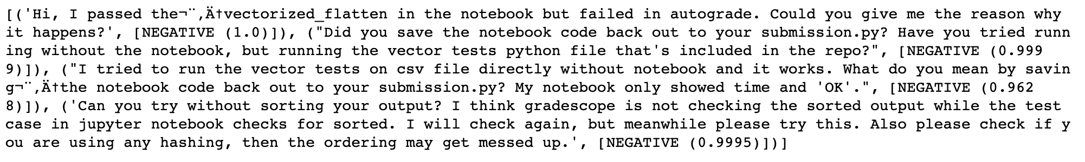
Sentiment Analysis updates
Completed the sentiment analysis of the data using:
- Flair: Generates a sentiment along with the confidence level.
Currently it takes about 65-70 minutes for 1494 posts
Looking for processing comments in batches
- Textblob: Generates a polarity score between -1 to 1
Still working on outputting the data onto the csv file.
Working with the web-dev team to integrate these results.
Notes:
Malav

Slide 9
Cognitive Presence (Garrison et al., 2001)
0: No Cognitive Presence
1: Triggering Event
2: Exploration
3: Integration
4: Resolution
Logistics
Socializing
“Thank you”
Unclear comments (code without comment)
Short questions
Technical clarification
“I am clueless”
“I think this is right/wrong”
Focus on the problem itself
Describing a problem
Giving suggestions
Partial understanding
Clarifications with detailed description or own assumptions
Proposing a solution
Giving their solution
Giving a textbook or other reference
Partial solutions
Confirmation of ideas
Elaboration on solution
Explain why/how solution works in detail
Definite comments
Comments from instructors
Direct answer
Notes:
Malav

Slide 10
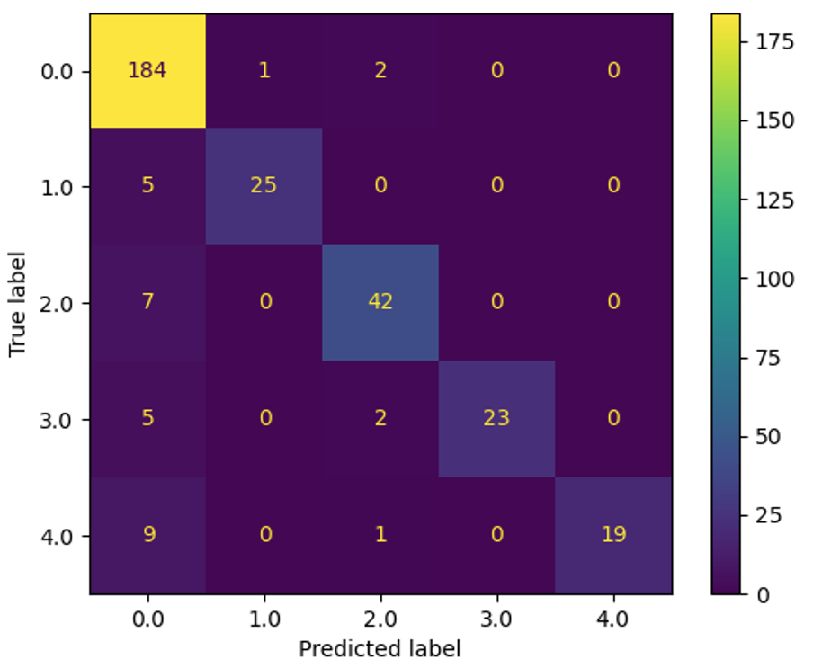
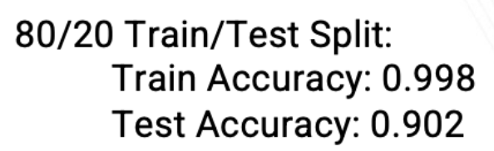
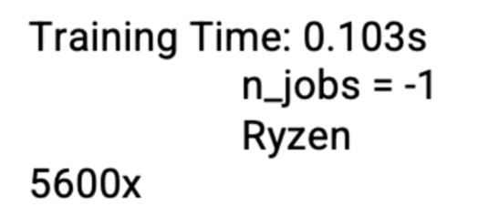
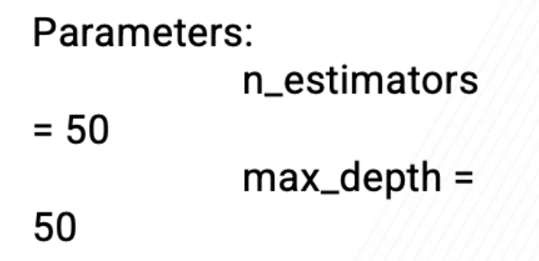
Cognitive Presence Modeling updates
Working on analyzing the BERT Model and generating outputs based on the new data.
For the next few weeks:
will work on outputting the data onto the csv file based on the output requirements (for the professors).
start running the current data on the BERT model and recording the output
if time permits, will work on improving the accuracy of the Cognitive Presence model.
Notes:
Malav

Slide 11
Social Presence updates
Read other studies that looked at social presence in online classes in order to gain perspective on the specific questions that can be asked, and the methods used regarding this topic
Developed more narrow research questions that I will look into for the rest of the semester:
  How does the presence of instructors in a thread relate to students’ cognitive and social presence?
  Which students are contributing the most in discussion forums? How can these students be characterized?
  How do social factors influence student outcomes in the class?
Notes:
Sarah
social presence desks more with looking at students as individuals

Slide 12
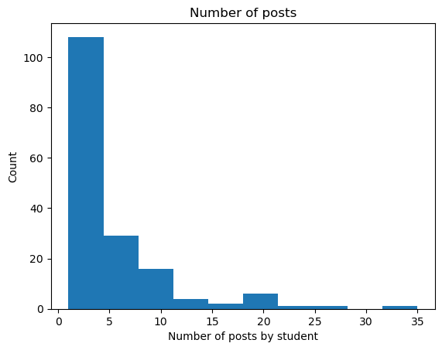
Student Outcomes Analysis updates
Examined cognitive presence, number of comments, length of posts, sentiment, timing, types of posts
Notes about data set
  Only have passing students (169 total)
  Organized in megathreads
Number of answers
Cognitive presence
Final grades
Number of posts
Timing of posts
Notes:
Nidhi
organized in megathreads: the follow-ups are sometimes the answer, which makes categorizing by post type a little tricky

Slide 13
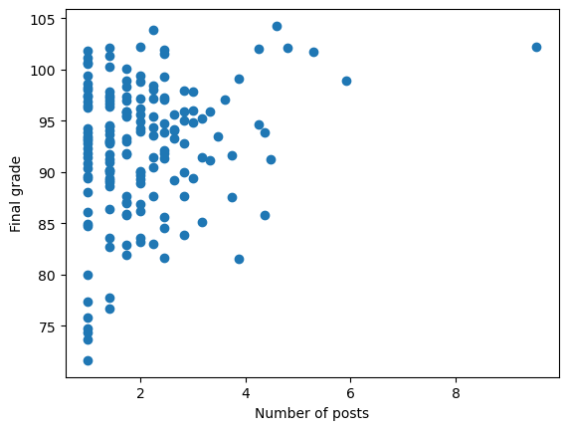
Student Outcomes Analysis (cont)
Interesting features:
  Highest correlation with final grades: number of follow-ups (0.27)
  Followed by average CP (.13)
Basic multiple regression model
Next steps:
  Identify more features & clean
  Explore other regression models

Slide 14
UX Research
Notes:
Gautam

Slide 15
User Surveys & Interviews - updates
Recap:
    Our goal is to create a dashboard for instructors which shows statistics and visualization relating to how students are utilizing Piazza and other discussion forums
      We wanted to know what metrics Professors and TAs want to be represented in the dashboard
    Need to make a survey to gauge interest in certain metrics
Survey has been made:
    We provide multiple possible metrics that can go on the dashboard and allow the professors and TAs to tell us which ones they think would be the most helpful for them
    We also give them the ability to propose their own metrics and ask if they would be willing to be contacted to provide more information if needed
Notes:
Gautam

Slide 16
User Surveys & Interviews - Challenges & Goals
Challenges encountered:
  The questions from last year were not usable because they were too confusing
    Used terms such as “cognitive presence” and “sentiment analysis” without sufficiently explaining them
      This is one of the things that we fixed for this year’s survey
Expectations for the end of semester:
  We need to send out the survey
    Need to choose a wide variety of professors and TAs across various subjects
  Data Analysis
    Will need to look into what metrics were ranked the highest and identify them to be placed on the dashboard
Notes:
Gautam

Slide 17
Web Development

Slide 18
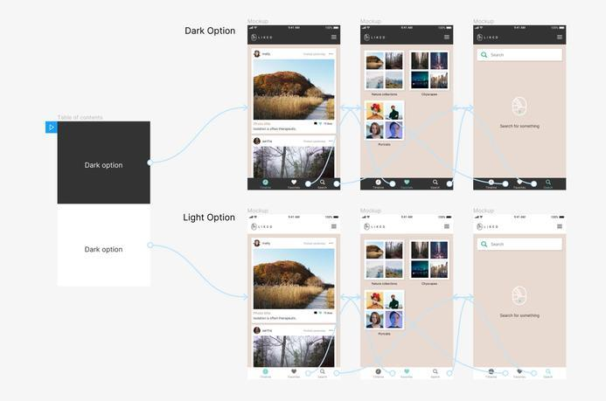
Front-End Web Development
Challenges of Coding Front-End “Too Early”
a big time commitment up-front
not very flexible to feedback
  or changing requirements
“going in blind”
Solution?
clickable prototypes
  faster to make
  easier to edit
  able to get more constructive user feedback on designs
  allows experimentation with drastically different layouts/content
made with Figma and interactive prototyping feature
  link to demo
Notes:
Sambhav

Slide 19
User Feedback
Rapid user feedback!
From a few teaching assistants for CS 2340: Objects and Design
Some comments/recommendations:
  Content:
    “professors can bookmark specific statistics for ease-of-access”
    “allow professors to compare classes”
      “or even the same class but from previous semesters”
    “how do professors dismiss warnings or alerts?”
    “allow professors to download data for own use”
  Design:
    “make graphs as clear as possible; have a zoom in feature”
    “insights take up too much space, more room for statistics”
    “add more icons for look and readability”
    “scrolling through graphs might be annoying”

Slide 20
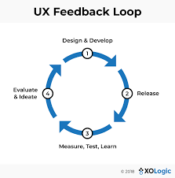
Next Steps
Continue user testing, gathering feedback
  get prototype in the hands of as many people
  refine prototype as much as possible
  combine findings with survey/interview results
Solidify structure
  more meetings with data science team
  creating a more functional application
Research more about:
  UX/UI design and best practices
  how to get the most out of feedback
  create document for future semesters

Slide 21
Back-End Web Development
Focused more on the research aspect uptil now this semester
  Revised the survey content from last semester and added some additional questions
  Sending out the Google Form survey that ask instructor and TA’s relevant information about courses
Discussed interviewing more professors to get more insight
Had a meeting with members of the Data Science team to talk about web-app integration
Next steps: work on producing a full stack model.
Notes:
Aanya

Slide 22
Conclusion
By the end of semester, we’re targeting the following deliverables:
Project Roadmap
  Working prototype of dashboard that displays results from original Piazza data - sentiment vs time, etc.
Data science
  Formulate 4-5 key metrics that are of highest relevance to instructors, and build models to automatically compute those from the Piazza data
  Study factors influencing social presence and impact on student outcomes
Web development
  Integration with the predictive models on the backend, and explore data ingestion directly from Piazza into SQL database
Notes:
To conclude, the goals for the end of the semester will be to get a working prototype of the web-app displaying results based on actual Piazza data. One of the metrics we’re looking at is the overall sentiment as the course progresses. In that spirit, the web-app team is working closely with the Data Science team to integrate their models into the web-app, and simultaneously conducting UX studies using surveys and interviews with instructors. In addition, the data science team is working on studying factors that have the highest impact on student participation in forums, and in turn the overall learning outcomes. Thank you for your time.

Slide 23
Citations
Garrison, D. R., Anderson, T., & Archer, W. (1999). Critical Inquiry in a Text-Based Environment: Computer Conferencing in Higher Education. The Internet and Higher Education, 2(2–3), 87–105. https://doi.org/10.1016/S1096-7516(00)00016-6
Garrison, D. R., Anderson, T., & Archer, W. (2001). Critical thinking, cognitive presence, and computer conferencing in distance education. American Journal of Distance Education, 15(1), 7–23. https://doi.org/10.1080/08923640109527071
Devlin, J., Chang, M. W., Lee, K., & Toutanova, K. (2018). Bert: Pre-training of deep bidirectional transformers for language understanding. arXiv preprint arXiv:1810.04805.
Medhat, Walaa, Hassan, Ahmed, Hoda, Korashy (2014). Sentiment analysis algorithms and applications: A survey. Ain Sham Engineering Journals. https://doi.org/10.1016/j.asej.2014.04.011

Slide 24
Questions?

